Slide 1
3D Accelerometer
Presenter : Yu Chen
Advisor : Jian-Jiun Ding , Jian-Hua Wang

Slide 2
Outline
Introduction
3D Accelerometer
Applications about 3D accelerometers
A Real-Time Human Movement Classifier
Analysis of Acceleration Signals using Wavelet Transform
Conclusion
Reference

Slide 3
Outline
Introduction
3D Accelerometer
Applications about 3D accelerometers
A Real-Time Human Movement Classifier
Analysis of Acceleration Signals using Wavelet Transform
Conclusion
Reference

Slide 4
Introduction
Accelerometer is a device which can detect and measure acceleration.

Slide 5
Introduction
There are a lot of types of accelerometers
  Capacitive
  Piezoelectric
  Piezoresistive
  Hall Effect
  Magnetoresistive
  Heat Transfer
Notes:
Capacitive-Metal beam or micromachined feature produces capacitance; change in capacitance related to acceleration
•Piezoelectric-Piezoelectric crystal mounted to mass –voltage output converted to acceleration
•Piezoresistive-Beam or micromachinedfeature whose resistance changes with acceleration
•Hall Effect-Motion converted to electrical signal by sensing of changing magnetic fields
•Magnetoresistive-Material resistivity changes in presence of magnetic field
•Heat Transfer-Location of heated mass tracked during acceleration by sensing temperature

Slide 6
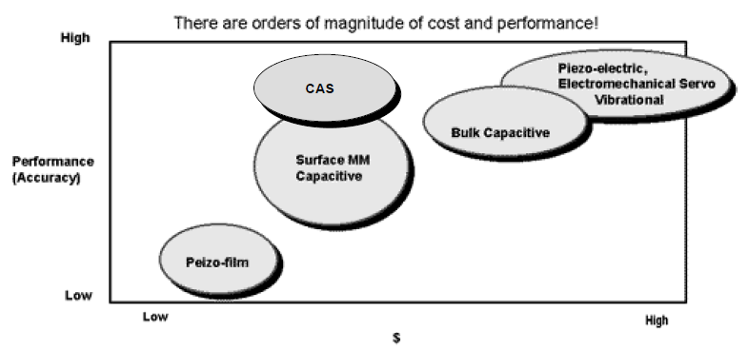
Introduction

Slide 7
Outline
Introduction
3D Accelerometer
Applications about 3D accelerometers
A Real-Time Human Movement Classifier
Analysis of Acceleration Signals using Wavelet Transform
Conclusion
Reference

Slide 8
3D Accelerometer
Basic Principle of Acceleration
  Velocity is speed and direction so any time there is a change in either speed or direction there is acceleration.
  Earth’s gravity: 1g
  Bumps in road: 2g
  Space shuttle: 10g
  Death or serious injury: 50g

Slide 9
3D Accelerometer
Basic Accelerometer
  Newton’s law
  Hooke’s law
  F = kΔx = ma

Slide 10
3D Accelerometer
Piezoelectric Systems

Slide 11
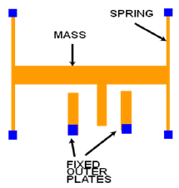
3D Accelerometer
Electromechanical Systems

Slide 12
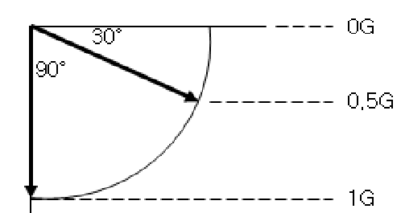
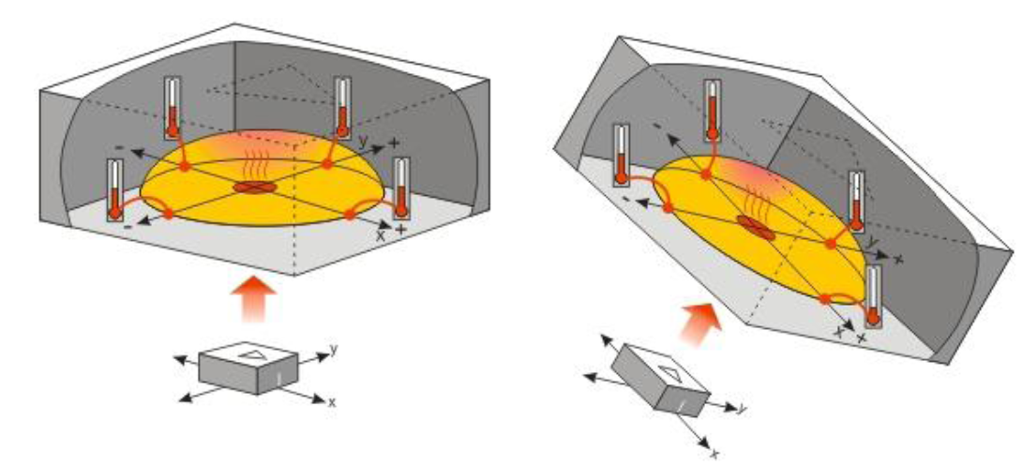
3D Accelerometer
Tilt angle

Slide 13
Outline
Introduction
3D Accelerometer
Applications about 3D accelerometers
A Real-Time Human Movement Classifier
Analysis of Acceleration Signals using Wavelet Transform
Conclusion
Reference

Slide 14
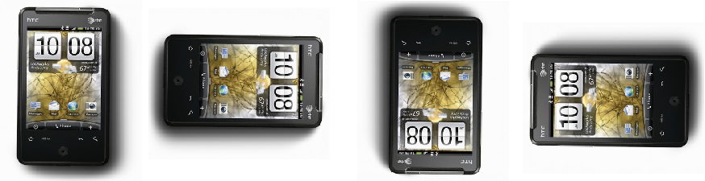
Applications about 3D accelerometers
Calculate the user’s walking state
Analyze the lameness of cattle
Detect walking activity in cardiac rehabilitation
Examine the gesture for cell phone or remote controller for video games

Slide 15
Outline
Introduction
3D Accelerometer
Applications about 3D accelerometers
A Real-Time Human Movement Classifier
Analysis of Acceleration Signals using Wavelet Transform
Conclusion
Reference

Slide 16
A Real-Time Human Movement Classifier

Slide 17
A Real-Time Human Movement Classifier
Human body’s movements are within frequency below 20 Hz (99% of the energy is contained below 15 Hz)
Median filter
  remove any abnormal noise spikes
Low pass filter
  Gravity
  bodily motion

Slide 18
A Real-Time Human Movement Classifier
Activity and Rest
  Appropriate threshold value
  Above the threshold -> active
  Below the threshold -> rest

Slide 19
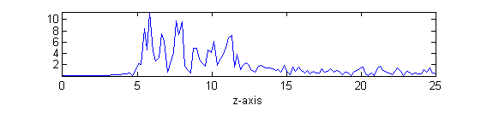
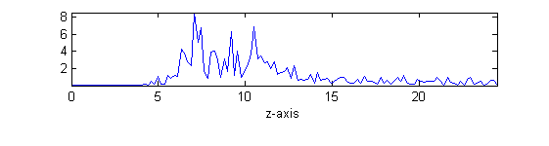
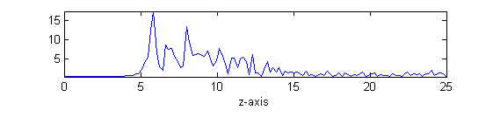
A Real-Time Human Movement Classifier
Walk
Upstair
Downstair

Slide 20
Outline
Introduction
3D Accelerometer
Applications about 3D accelerometers
A Real-Time Human Movement Classifier
Analysis of Acceleration Signals using Wavelet Transform
Conclusion
Reference

Slide 21
Analysis of Acceleration Signals using Wavelet Transform
Wavelet Transform
g[n]
↓ 2
x_{LL}[n]
g[n]
↓ 2
x_{L}[n]
h[n]
↓ 2
x_{LH}[n]
x[n]
g[n]
↓ 2
x_{HL}[n]
h[n]
↓ 2
x_{H}[n]
h[n]
↓ 2
x_{HH}[n]

Slide 22
Outline
Introduction
3D Accelerometer
Applications about 3D accelerometers
A Real-Time Human Movement Classifier
Analysis of Acceleration Signals using Wavelet Transform
Conclusion
Reference

Slide 23
Conclusion
Recent Research Direction
  Statistical property
  Wavelet transform
  Signal feature
Future Research Direction
  Machine learning
  Time frequency analysis

Slide 24
Outline
Introduction
3D Accelerometer
Applications about 3D accelerometers
A Real-Time Human Movement Classifier
Analysis of Acceleration Signals using Wavelet Transform
Conclusion
Reference

Slide 25
Reference
P. Barralon, N. Vuillerme and N. Noury, “Walk Detection With a Kinematic Sensor: Frequency and Wavelet Comparison,” IEEE EMBS Annual International Conference New York City, USA, Aug 30-Sept 3, 2006
M. Sekine, T. Tamura, M. Akay, T. Togawa, Y. Fukui, “Analysis of Acceleration Signals using Wavelet Transform,” Methods of Information in Medicine, F. K. Schattauer Vrlagsgesellschaft mbH (2000)
Elsa Garcia, Hang Ding and Antti Sarela, “Can a mobile phone be used as a pedometer in an outpatient cardiac rehabilitation program?,” IEEE/ICME International Conference on Complex Medical Engineering July 13-15,2010, Gold Coast, Australia

Slide 26
Reference
Niranjan Bidargaddi, Antti Sarela, Lasse Klingbeil and Mohanraj Karunanithi, “Detecting walking activity in cardiac rehabilitation by using accelerometer,”
Masaki Sekine, Toshiyo Tamura, Metin Akay, Toshiro Fujimoto, Tatsuo Togawa, and Yasuhiro Fukui, “Discrimination of Walking Patterns Using Wavelet-Based Fractal Analysis,” IEEE TRANSACTIONS ON NEURAL SYSTEMS AND REHABILITATION ENGINEERING, VOL. 10, NO. 3, SEPTEMBER 2002
“ Accelerometers and How they Work ”
“ Basic Principles of Operation and Applications of the Accelerometer ” Paschal Meehan and Keith Moloney - Limerick Institute of Technology.

Slide 27
Reference
From the lecture slide of “ Time Frequency Analysis and Wavelet Transform” by Jian-Jiun Ding

